Slide 1

Mini Bees Creche
Presented By: Team bluewave

Slide 2








Project Team
Adeola Kazeem
Team Member
Chijioke f. Ijezie
Team Member
Chinemeze Adieze
Team Member
Ikanniwa Soyinka
Team Member
Linda C. Munonye
Team Member
Melody Ibezim
Scrum Master
Precious Ukpai
Team Member
Ufuoma Ifoghale-Ekinodo
Team Member
April 2024

Slide 3
Project Mandate
The creche is looking to develop a web platform for their business. The current process is basically manual but due to expansion & increased patronage from new immigrants into London in United Kingdom, it is no longer scalable. Our team has been commissioned to develop a digital solution that is mobile-centric to transform the whole process from converting new lead to onboarding them into the system in delivering seamless services to the clients. We have 6 weeks to complete this project. The budget is £500,000
April 2024

Slide 4
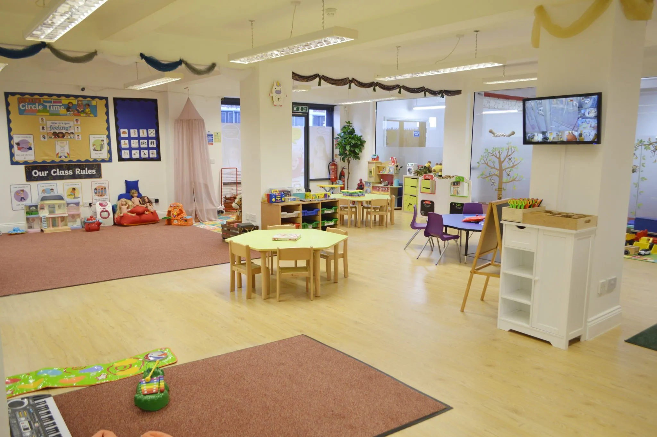
PROBLEM STATEMENT
Mini Bee Creche is a top-notch daycare service provider located in London, United kingdom. The demand for its services has increased due to influx of immigrants, apparently 37% of immigrants in United Kingdom reside in London, currently the process of registering and onboarding children is manual, this has resulted in inefficiency and limitations of onboarding new parents where 1 in 10 of mothers with children 0-4 years quit work over childcare. Furthermore, other challenges are poor TAT, heavy workload for staff resulting to clerical errors that has negatively impacted growth, productivity, staff retention, competitiveness and ROI.
Project Timeline: 6 weeks
April 2024

Slide 5
Highlights
As of 2022, 14.8% of all UK residents are foreign-born
37% of immigrants in United Kingdom reside in London
1 in 10 of mothers with children 0-4 years quit work over childcare
Increase in new clients leading to more demand for services
Manual processing of requests
Increase in staff workload and clerical errors
Team Bluewave
April 2024

Slide 6
Problem Statement
Increase in new clients
Manual processing of requests
Increase in staff workload and clerical errors
Increase in waiting time, and ineffective communication
Parents
Staff
Creche Owners/Managers
Local Council/Ofsted
1
Who
Why
4
London, United Kingdom
2
Where
A mobile-centric web platform
3
What
When
Six (6) Weeks
5

Slide 7
Business Case Artefacts deliverables
Objectives
Vision & Goal
Root Cause Analysis
Stakeholder Power & Influence Grid
Stakeholder Communication Plan
RACI Matrix
Swot Analysis
Risk Assessment Matrix
Competitor Analysis
Option Analysis
Cost Benefit Analysis
Process Flow Map (As-Is)
Process Flow Map (To-Be)
Gap Analysis
Survey Results
MoSCoW Matrix
Agile Work Breakdown Structure
Use Case Diagram
Customer Journey Map
Personas

Slide 8
Vision & Goal
Objectives
Complete the development and launch of a mobile-centric web platform within six weeks for Mini Bees crèche utilizing a budget of £500,000 to:
Automate the onboarding process
Enhance communication and engagement
Reducing registration time by 50% and increasing enrolment into the creche at the start of the new school term by 25%.
To provide a seamless and engaging Mobile-Centric web platform for Mini Bees crèche, providing a convenient and efficient process from lead conversion to client onboarding, improving futuristic and realistic service delivery.

Slide 9
Root Cause Analysis
The Problem
Inept Registration and Onboarding Process
WHY IS IT HAPPENING?
Onboarding process is not automated hence the need for a website
WHY IS THAT?
In-efficient communication of the creche’s services and registration process
WHY IS THAT?
Immigrant families new to the area may not have access to traditional means of finding childcare options such as referrals or local networks
WHY IS THAT?
They may come from countries where childcare options are organized differently or where they have relied on extended family for childcare
WHY IS THAT?
Cultural or language barriers might limit access to information, therefore a website is more accessible option
Root Cause
The lack of familiarity with local childcare option by immigrants. This necessitates creating a website to effectively communicate our services to the new demographic

Slide 10




Keep Satisfied
Manage Closely
HIGH INFLUENCE
Local Council/Ofsted
Creche Owners/Manager
STAKEHOLDER
INFLUENCE MAP
LOW INTEREST
HIGH INTEREST
Monitor
Keep Informed
Staff [Subject Matter Experts(SMEs)]
Parents
Web Developer
LOW INFLUENCE

Slide 11
Stakeholder Communication Plan
Unique Identifier | Stakeholder | Engagement Action | Channel | Frequency | Sender
S1 | Creche Owners/Manager | Actively Engaged | Personal Check-ins Email | At the end of each phase | BA
S2 | Local Council/Ofsted | Keep Satisfied | Emails | At the end of the project | BA
S3 | Staff | Keep Informed | Meetings Emails | Daily | BA
S4 | Web Developer | Keep Informed | Meetings Emails | Daily | BA

Slide 12
A = Accountable
R = Responsible
C = Consulted
I = Informed
RACI Matrix
Creche Owner/Proprietor
Project Manager
Web Developer
Business Analyst
Staff
Product Management | C | I | R | R | I
Information Gathering | C | A | C | R | C
Design & development | C | A | R | C | I
User Testing | I | A | R | A | C
Launch platform | I | A | R | I | I
Monitor performance & provide ongoing support/maintenance | I | R | A | I | I

Slide 13
Mini Bee Creche
SWOT ANALYSIS
S
W
O
T
01
02
03
04
Strengths
Weaknesses
Opportunities
Threats
Strong presence in the community
Onboarding process is manual
Improved Communication & Engagement
Technical Issues
Data Security Risk
Its central location
Feedback Mechanism
Resistance to Change
Resistance to Change
Quality Childcare Services
Market Expansion
Data Insight
Regulatory Compliance
Experienced & qualified childcare professionals
Improved Efficiency
Competitor Response

Slide 14



Risk Assessment Matrix
 |  | IMPACT
 |  | LOW (1) | MEDIUM (2) | HIGH (3)
PROBABILITY | VERY LIKELY (3) | LOW (3) | MEDIUM (6) | HIGH (9)
 | MODERATE (2) | LOW (2) | MEDIUM (4) | MEDIUM (6)
 | UNLIKELY (1) | LOW (1) | LOW (2) | LOW (3)
 | Probability | 2 | x | 3 | Impact
 | RISK LEVEL
 |  |  | 6
 | MEDIUM
LOW RISK
Unlikely to cause an injury but action can still be taken to reduce this group more.
MEDIUM RISK
Need to control measures and do what you can to reduce the risk.
HIGH RISK
Special control measures must be in place and training. This group is reviewed to try and reduce the risk where possible, but this is not always the case.

Slide 15
Risks | Description | Mitigation | Risk Score
Data Security and Privacy | Clients would provide sensitive information on the digital platform., the occurrence of data breach can harm the reputation of the creche | Ensure compliance with relevant data protection regulations such as GDPR (General Data Protection Regulation). Implement robust security measures such as encryption, access controls, and regular security audits. Provide clear privacy policies and obtain explicit consent from users before collecting their personal data | 6
Time Constraints | The time assigned poses a risk of insufficient time for thorough testing, refinement and unexpected challenges that may arise during the development | Prioritizing tasks based on their criticality to the project goals and allocating time accordingly. | 9
User Adoption and Training | Resistance from staff and clients accustomed to manual processes and difficulty adapting to the new digital platform | Involve stakeholders early in the project and ask for their input to ensure the platform meets their needs.Provide comprehensive training and support to both staff and clients to facilitate smooth adoption of the new system and gather feedback o address potential usability issuesOffer user-friendly interfaces and intuitive design to minimize the learning curve. | 1
Technical Challenges | Might occur if there are compatibility issues across different devices and operating systems during the development of the website | Utilize prototyping and testing to identify and address technical challenges early in the project lifecycle and develop a contingency plan for potential technical obstacles | 6
Scope Creep | The possibility that the requirements can be changed or more added during the project and the risk of not meeting clients expectation | Clearly define the project scope and establish change control procedures. Regularly review and prioritize requirements to ensure alignment with the project goalsCommunicate project mile stones and manage clients expectations through regular updates | 8
Budget Constraint | Unexpected cost may arise during the project which can potentially lead to cost overuns | Develop a detailed budget that includes contingencies, regularly monitor expenditure and adjust the budget as needed | 3

Slide 16
Competitor Analysis
Features | Mini Bees Creche | Zeeba Daycare Dalston | Tiddley Tots Nursery | First Day Nursery
Digital Prescence | Poor | Good | Excellent | Good
Number of Locations | 1 | 1 | 3 | 2
Hours of Operation | 6:30 – 19:00 | 6:00 – 18:00 | 8:00 – 17:00 | 7:30 – 19:00
Fees (£) | 55 | 65 | 55 | 45
Unique Services | Language Immersion Programs | Music Classes | Community Garden Project | Weekend Care
Ranking (daynurseries.co.uk) | 8.9 | 9.4 | 7.1 | 8.5
Social Media Following (Facebook) | 164 | 121 | 388 | Nil

Slide 17
Option Analysis
Pros
Cons
1. In-House Development
Complete autonomy
Customization
Ability to incorporate unique features
Greater upfront investment
Potential Extension
Risk: Inexperience, Technical Challenges
2. Outsourcing to a Software Development Agency
Expertise & Experience
Accelerated Development
Potentially Cheaper
Forgo control of the process and outcome
Communication Risk
Schedule dependency
3. Hybrid Approach (Combination of 1 & 2)
Leveraging the strengths of both resources.
Flexible approach to challenges
Speed & cost-efficiency
Requires effective coordination and communication
Team Conflicts
Stakeholder and workflow complexity
4. Utilizing Pre-built Solutions or Platforms
Rapid deployment
Rapid deployment
Cost and time advantage compared to bespoke development
Customization limitations
Vendor dependency
Scalability Concerns as the requirements evolve
Recommendation
Option 2 : It affords versatility in the features that can be included, provides access to the expertise and resources required for the project, while there are risks associated with outsourcing, effective communication and project management can mitigate these risks

Slide 18
Option Analysis
Options | Pros | Cons | Specifications
In-House Development | Complete autonomy Customization Ability to incorporate unique features | Greater upfront investment Potential Extension Risk: Inexperience, Technical Challenges | Development Time - 8-12 weeks Budget - £500,000+ Customization Flexibility - High
Outsourcing the Project | Expertise & Experience Accelerated Development Potentially Cheaper | Forgo control of the process and outcome Communication Risk Schedule dependency | Development Time - 6-8 weeks Budget - £400,000-£500,000 Customization Flexibility - Medium
Hybrid Approach | Leveraging the strengths of both resources. Flexible approach to challenges Speed & cost-efficiency | Requires effective coordination and communication Team Conflicts Stakeholder and workflow complexity | Development Time - 6-10 weeks Budget - £450,000-£550,000 Customization Flexibility - Medium-High
Utilizing Pre-built Solutions or Platforms | Rapid deployment Cost and time advantage compared to bespoke development | Customization limitations Vendor dependency Scalability Concerns as the requirements evolve | Development Time - 4-6 weeks Budget - £300,000-£400,000 Customization Flexibility - Medium
Recommendation
Option 2 : This approach offers a balance between customizable features, project budget, and expected delivery time. It provides the versatility to include desired features while also providing access to the expertise and resources needed

Slide 19
Cost Benefit Analysis
Costs
Development Team: £150,000 - £250,000
Technology and Tools: £20,000 - £50,000
Design: £30,000 - £60,000
Mobile Optimization: £20,000 - £40,000
Integration and API Costs: £10,000 - £30,000
Testing and Quality Assurance: £20,000 - £40,000
Project Management and Contingency: £30,000 - £50,000
Training and Support: £10,000 - £20,000
Benefits
Streamlined registration & onboarding process
Enhanced staff productivity and cost efficiency
Increased Enrolment projected at 25% per term
Long-term Revenue Growth
Improved Communication and Engagement
Competitive Advantage
Data Insights & Brand Visibility
Customer Satisfaction
Cost Benefit Analysis
Long-term, the potential benefits outweigh the initial, significant amount spent, indicating a favourable return on investment

Slide 20
Cost Benefit Analysis
Development Team | 150,000 – 250,000 | Optimized onboarding
Technology & Tools | 20,000 - 50,000 | Enhanced efficiency
Design | 30,000 - 60,000 | Boosted Enrolment
Mobile Optimization | 20,000 - 40,000 | Sustained Expansion
Integration & API | 10,000 - 30,000 | Improved Communication & Engagement
Testing & Quality Assurance | 20,000 - 40,000 | Competitive Advantage
Project Mgt & Contingency | 30,000 - 50,000 | Data Insights & Brand Visibility
Training & Support | 10,000 - 20,000 | Customer Satisfaction
Total | 290,000 – 540,000
Projected Income | 700,000 -1,000,000 | Profit margin between 46% - 59%
 |  | Projected 25% growth in 3 years
Description
Estimated Costs (£)
Non-Financial Benefits
Financial Benefits
Long-term, the potential benefits outweigh the initial, significant amount to be spent on outsourcing the development of the mobile centric platform to a software development agency, indicating a favourable return on investment

Slide 21
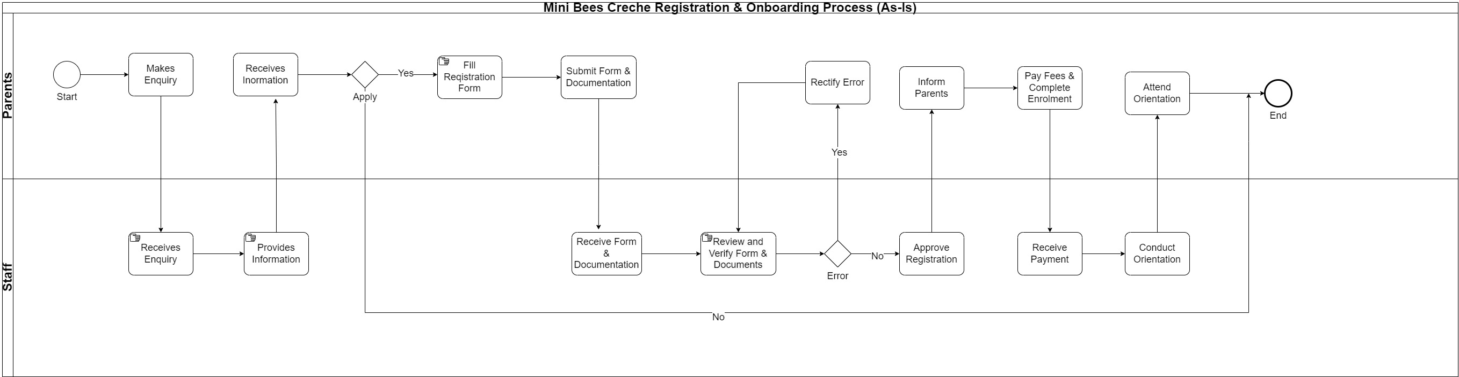
Process Flow Map (As-Is)

Slide 22
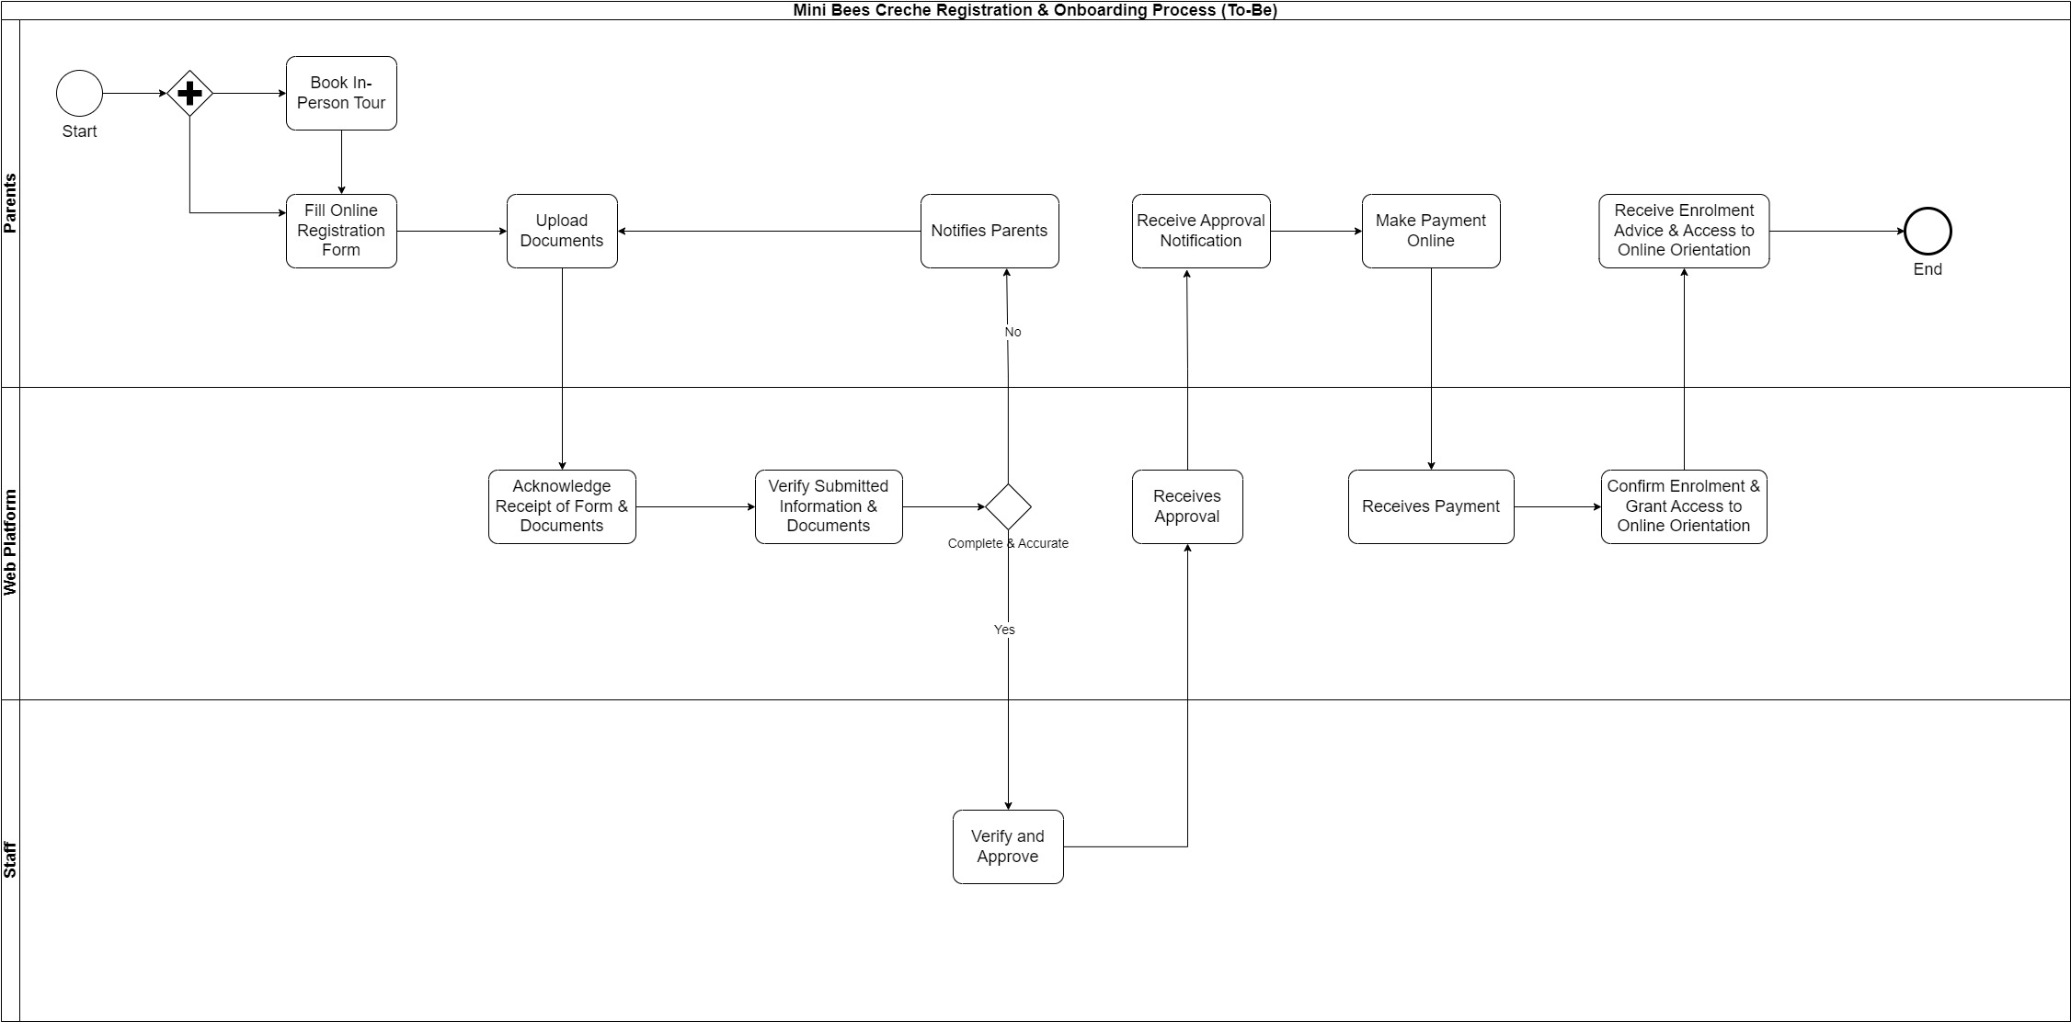
Process Flow Map (To-Be)

Slide 23
Gap Analysis
Current State | Gaps | Future State | Remedy
Manual registration & onboarding Paper-based system Manual Payment Ineffective communication & engagement Overburdened staff & Micromanagement | Inefficiencies & extended timeframes Potential errors & poor data quality Not user-friendly & cumbersome Breakdown in Communication Current Process is Inefficient & Demoralizing | 50% reduction in registration time & 25% increased enrolment online forms Digital Payment Methods Improved communication & engagement Operational excellence | Mobile-centric Platform With: Automated Registration & Onboarding System Centralized Database Automated Payment Systems Several communication channels Implementing Smart Processes & Staff Autonomy

Slide 24
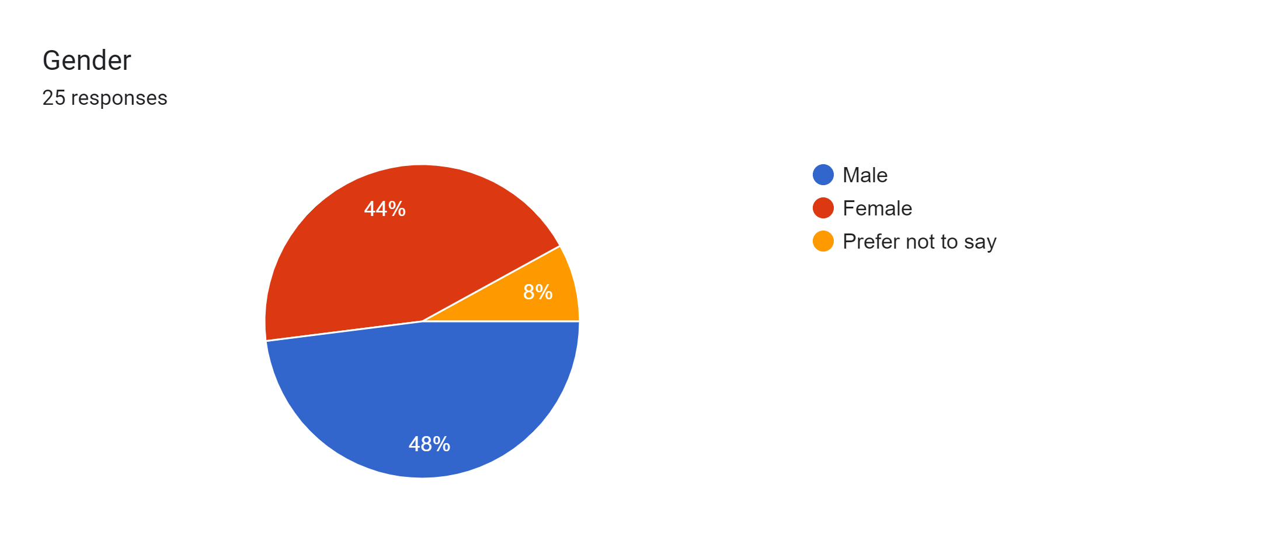
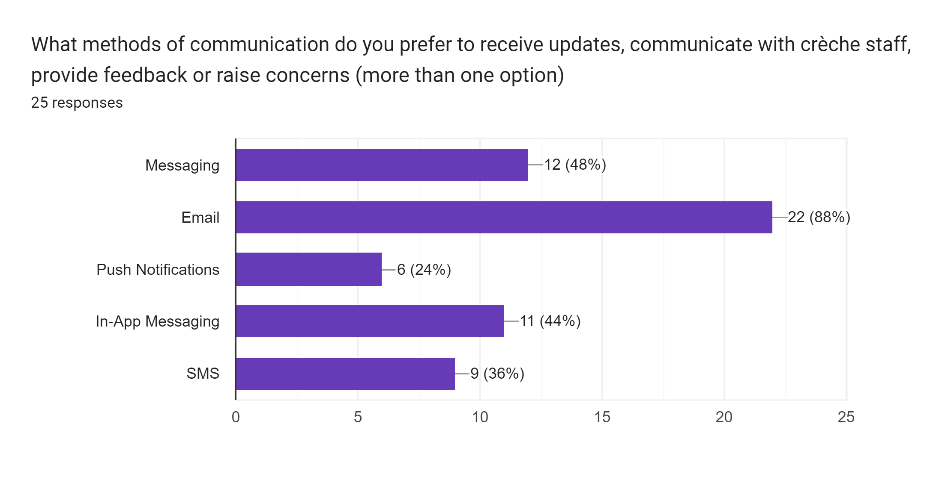
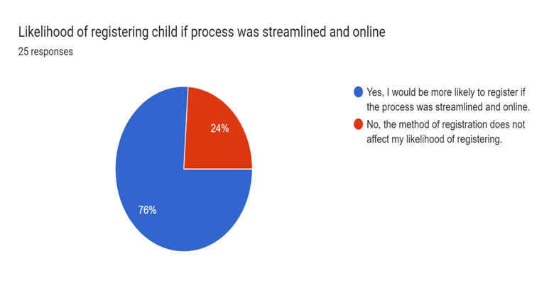
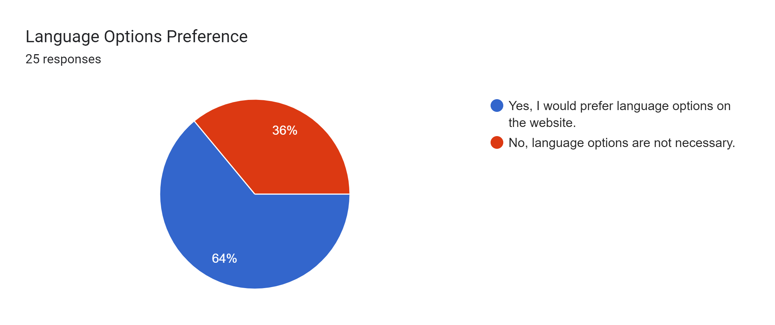
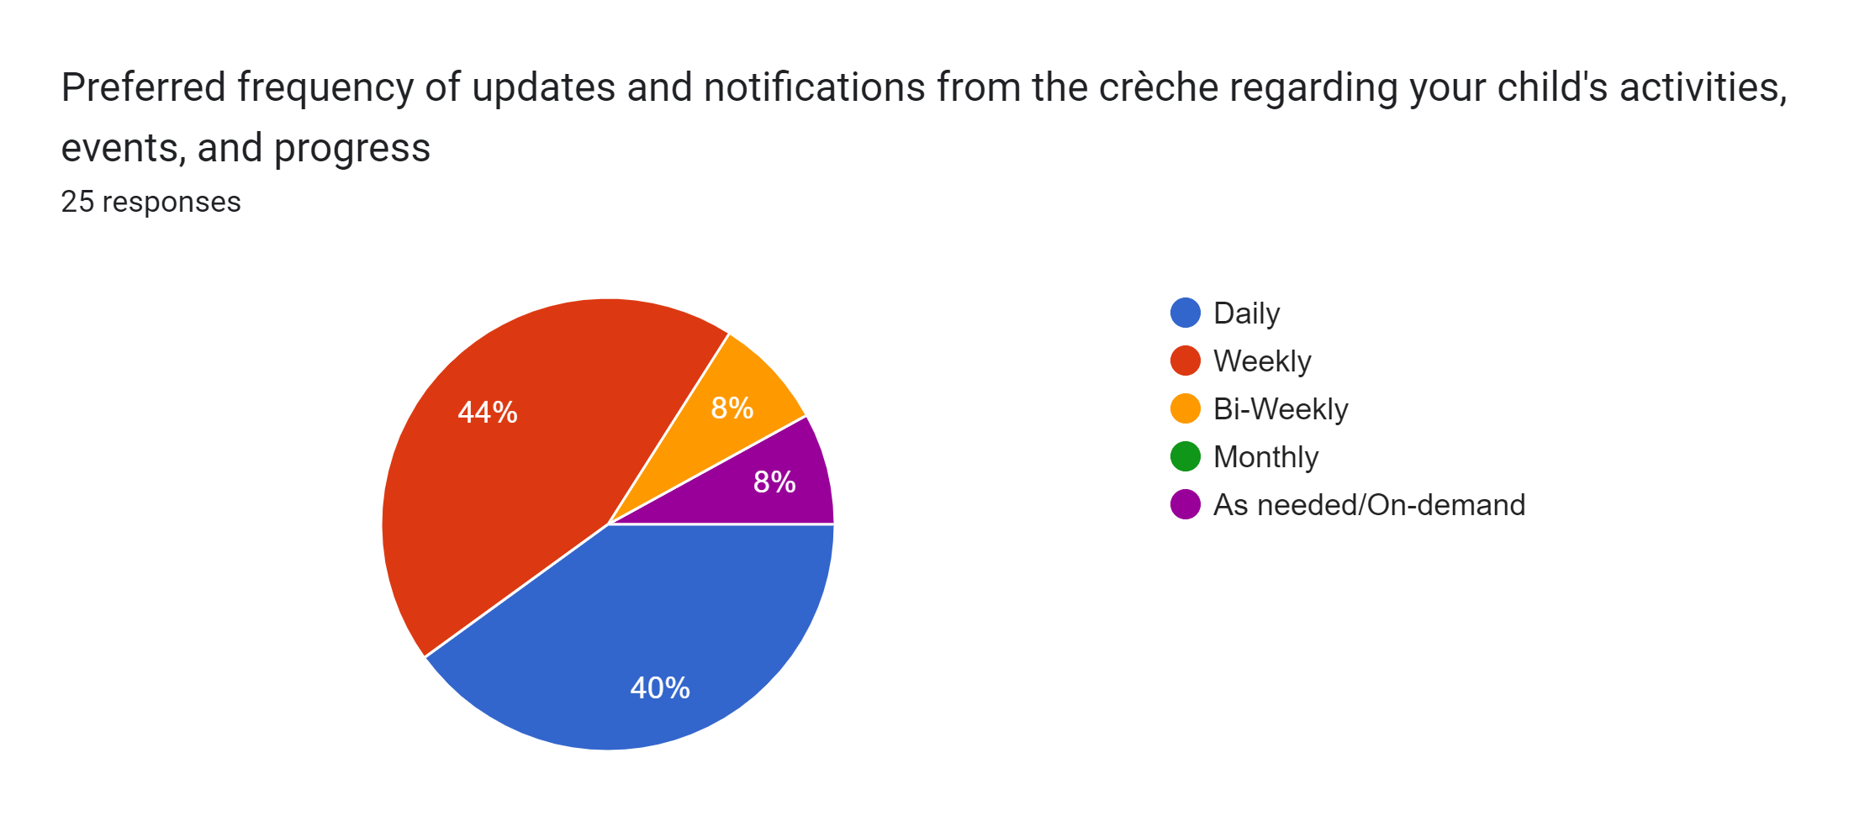
Survey Results

Slide 25
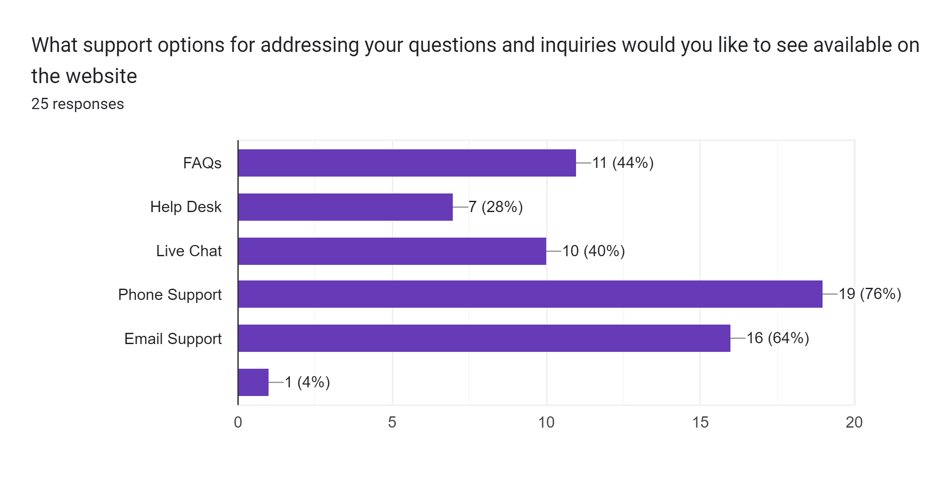
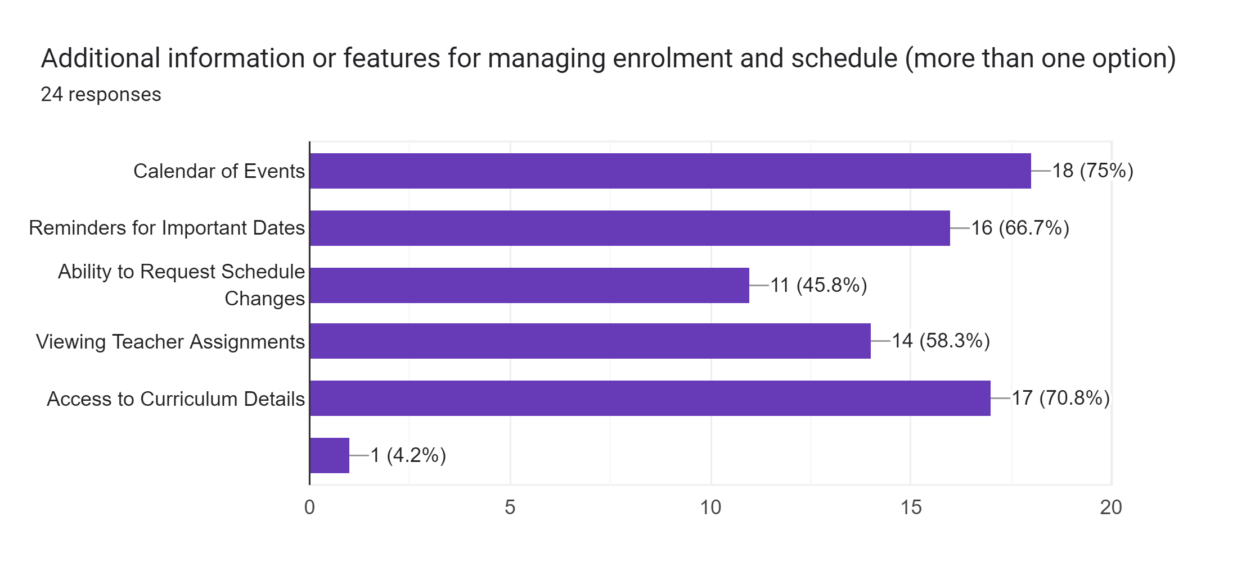

Slide 26
MoSCoW Matrix
User Registration
User Login
Digital Form
Dashboard For Management of New Registrations
Database for Storing Client Information
Mobile Friendly Interface
Different Payment Methods
Multimedia Gallery
Summary About The Creche
Creche Contact Numbers
Access To Enrolment Status & Class Schedule
Integration With Calendars For Reminders
Instant Messaging & FAQs
Integration Of Games
Intrusive Advertisement
Excessive Features That Could Lead To Confusion
Excessive Permission That Could Lead To Privacy Concerns
Multiple Language Options
Feedback & Review Sections
Social Media Integration
Notification for Important Events
Must Have
Should Have
Must Have
Could Have
Won’t Have

Slide 27
Agile Work Breakdown Structure
Mobile Centric Platform
Project Initiation
Planning & Requirements Gathering
Design & Prototyping
Development
Integration & Testing
Deployment & Launch
Post-launch Support & Optimization
Define project objectives, scope, & deliverables
Identify stakeholders & establish communication plan
Set up project management tools & infrastructure
Stakeholder Engagement
Create user stories and acceptance criteria
Develop wireframes & mockups
Define sprint goals & plan backlog refinement sessions`
UI/UX Design
Prototype development
Gather feedback from stakeholders
Conduct usability testing
Front-end Development
Integrate UI designs & prototypes
Client Validation
Optimize performance & responsiveness
Set up server infrastructure & database architecture
Implement user authentication & authorization features
Develop Frontend-Backend APIs
Quality Assurance
Develop WebApp
End-to-End Testing
Browser & Device testing
Bug fixing
Web deployment
Hosting Setup & Deployment Configuration
Staging Deployment
Coordinate UAT
Deploy & Launch website
Post-launch monitoring
Bug fixes
Iterative Improvements
Plan for future iterations & enhancements

Slide 28
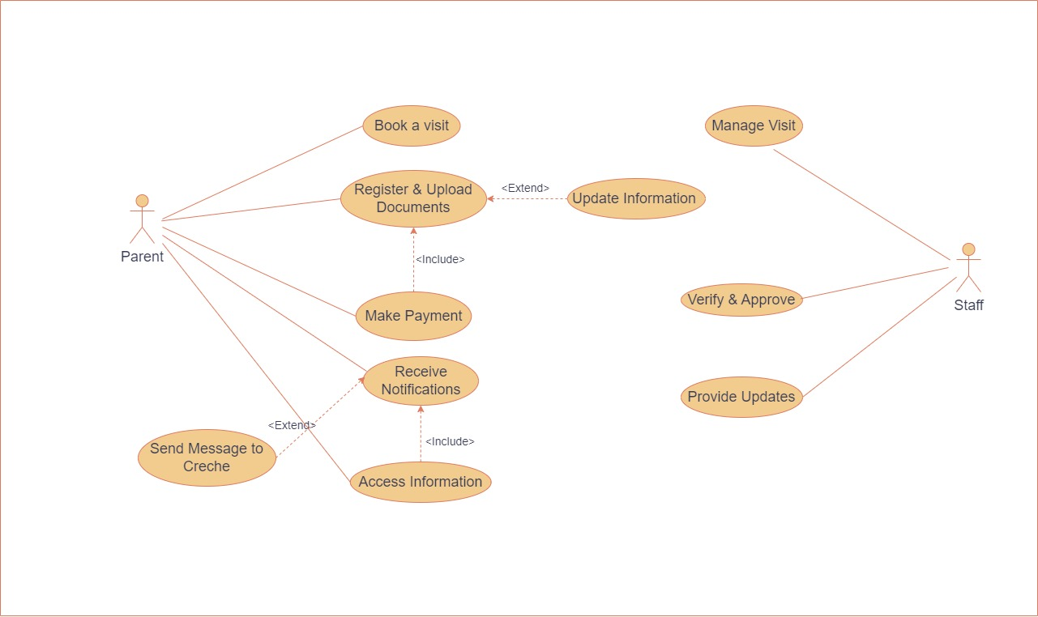
Use Case Diagram
Team Bluewave

Slide 29
Customer Journey Map
Journey Step /Stages | Awareness | Consideration | Decision | Service | Loyalty/Advocacy
Discovery | Find us online | Explore our Crèche website | Learn more about the crèche | Positive first impression with clear communication | Positive first impression drives engagement
Registration | Learn about registration info on website | Assess crèche for child's needs. | Creche reputation and impression drive registration | Complete registration form online | Easy signup, great service
Enrolment | Finalize enrolment | Receive enrolment confirmation & details | Prepare child for their first day at Crèche. | Drop off child for first day of attendance. | Positive start fosters confidence.
Ongoing Engagement | Get regular updates from the creche | Actively participate at crèche | Connect & share feedback | Experience quality care | Advocate for & collaborate with crèche staff

Slide 30

Persona
Goals
High-quality care and education
Monitor and track her child's progress
Frustrations
Juggling work and parenthood
Managing communication with the crèche and her busy schedule
Demographic Information
Needs
Access to real-time updates and information
Convenient payment options
Easy online registration & enrolment
Expectations
Clear and timely communication
Secure and reliable online payment
Syncs across devices
Age | 37
Education | Masters
Employment Type | Full-Time
Location | London
Sarah is a working mother of two children and a busy professional. She values efficiency and convenience
Personality
Organized
Proactive
Tech-Savvy
Touch Points
Website
Email
Phone
SMS
In-Person Interactions

Slide 31
Reference
https://www.icaresoftware.com/our-blog/major-trends-driving-the-childcare-industry/
https://migrationobservatory.ox.ac.uk/resources/briefings/children-of-migrants-in-the-uk/
https://iasservices.org.uk/how-many-immigrants-are-in-the-uk/
https://www.eyalliance.org.uk/early-years-settings-and-gdpr
https://www.daynurseries.co.uk/daynursery.cfm/searchazref/65432248364
https://minibeeschildcare.co.uk/our-team
https://www.bbc.com/news/business-67325993
https://migrationobservatory.ox.ac.uk/resources/briefings/children-of-migrants-in-the-uk/

Slide 32
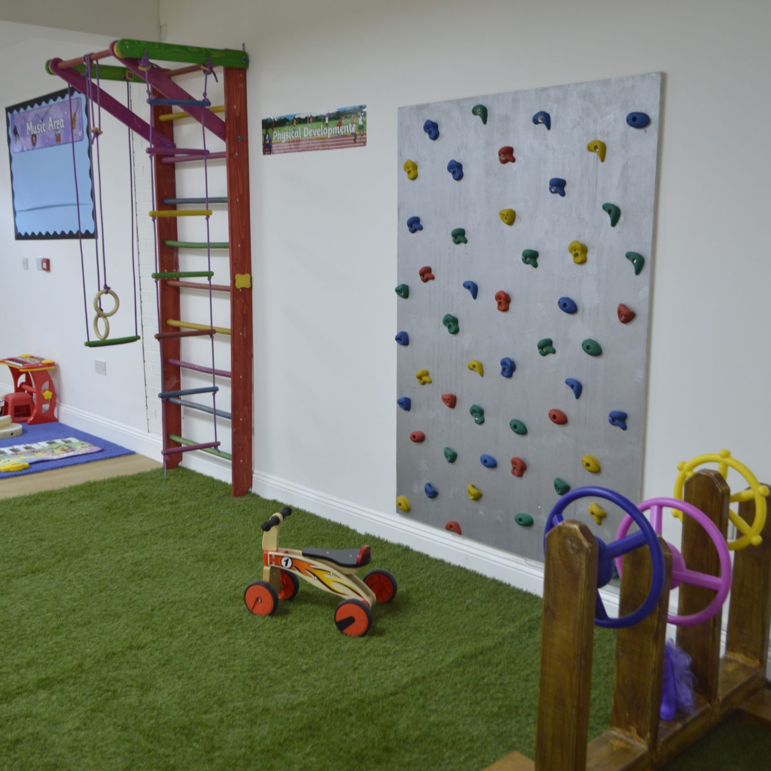
Thank You

